Slide 1
Influencer Impact Analysis
Project By:
Saumya Jaiswal

Slide 2
Introduction
Influencers are key players in any Social Network, due to their high indegree and low outdegree. They also affect fields like Marketing, for which the companies interested to market their product can use these ratios.
There are many other areas where this finding about "Influencer Impact Analysis" can play an important role as public opinion, which spreads quickly, determines trends.
Twitter is used widely by all kinds of influencers including political figures like Presidents of countries.

Slide 3
Abstract
The goal of this study is to analyse the effects of influencer’s tweets on their followers and to determine the follower’s reaction on different tweets.
In this project, we extracted recent tweets of 40 influencers and analysed the nature of those tweets as well as the response of their followers on those tweets.
The response of the followers was determined using the favourite count as well as the retweet count for each tweet. Finally, the impact of the tweet was analysed based on the normalized values of the mentioned two factors.

Slide 4
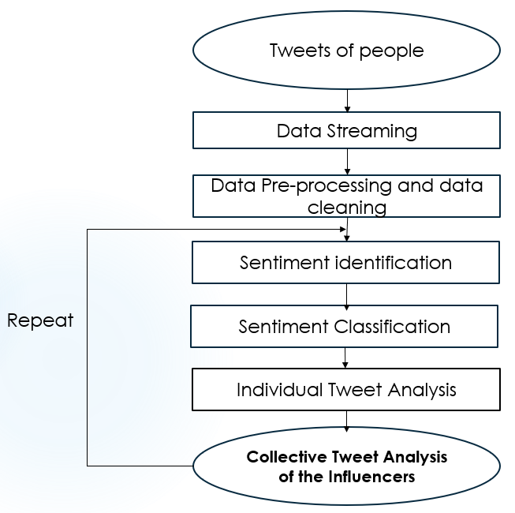
Flowchart

Slide 5
Methodology
Data extraction of various influencers via python.
Data pre-processing.
Data cleansing including removal of URLs, emojis, mentions, hashtags and non-alphabetic characters like punctuation marks.
Defining the sentiment function.

Slide 6
5. Importing the positive and negative classification dictionaries and tokenizing the text column.
6. Defining and applying the sentiment function to the dataset.
7. Calculating overall favourite count and retweet averages for normalization purpose.
8. Calculating these averages for positive and negative sentiments.

Slide 7
9. Computing normalized ratios.
10. Preparation and insertion of row for automated insertion into the output file.
11. Go to step 1 for analysis of next influencer.
12. Collective Sentiment Analysis and visualization.

Slide 8
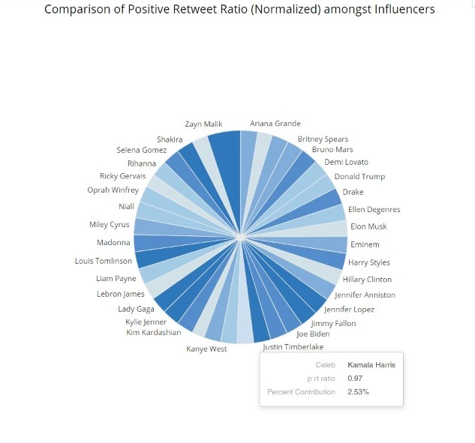
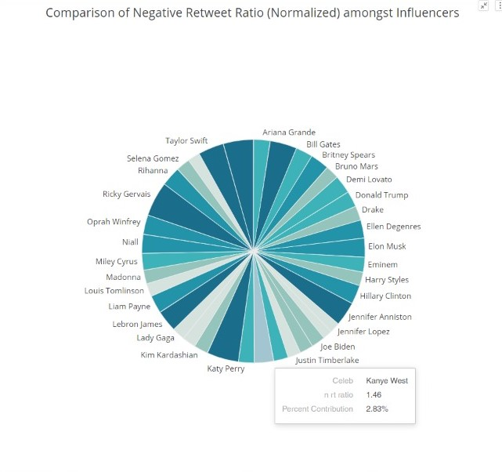
Observations as Visualizations

Slide 9
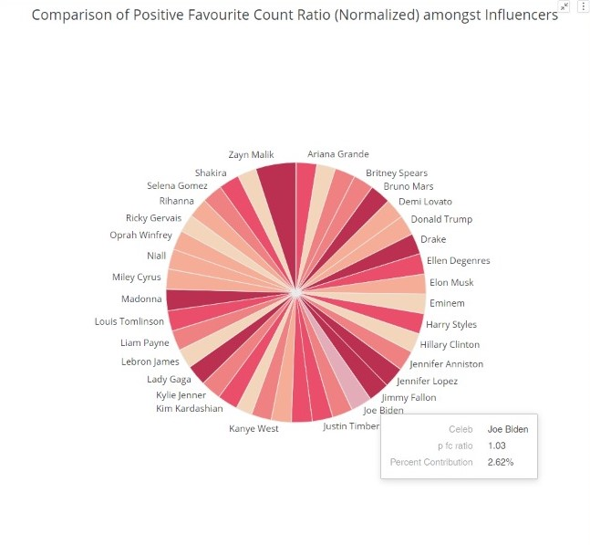
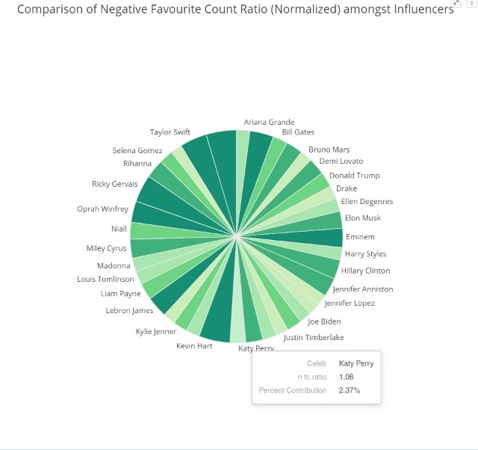

Slide 10
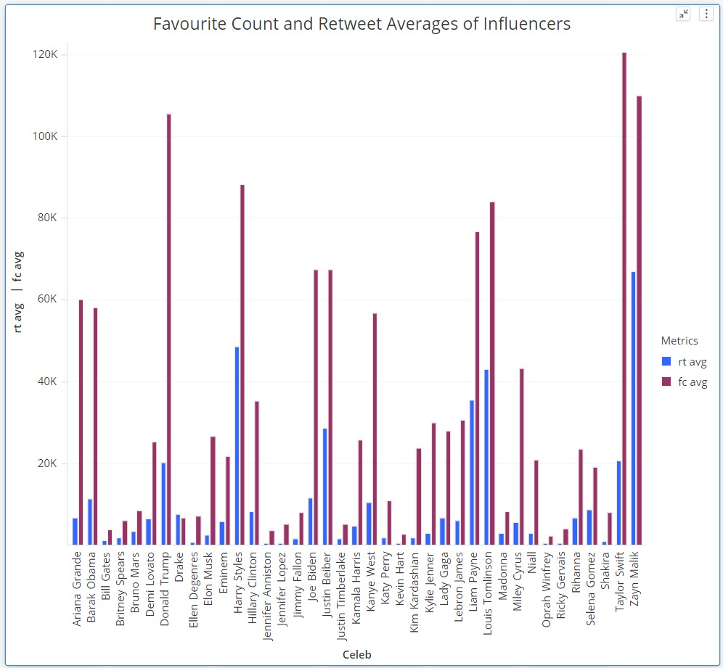

Slide 11
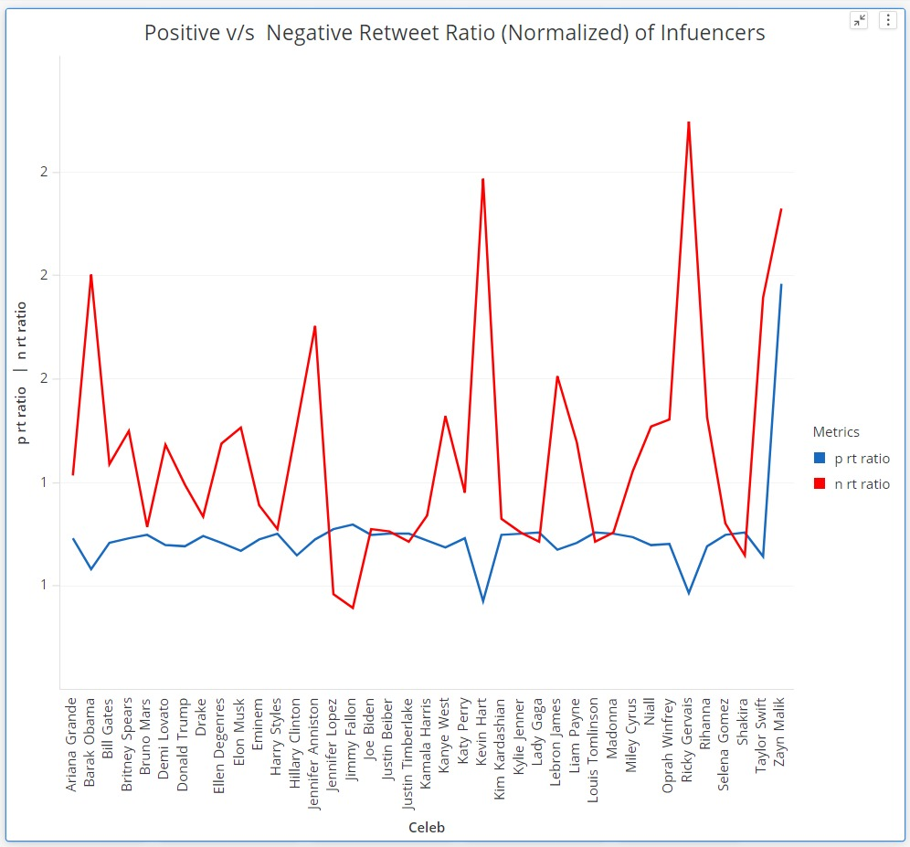
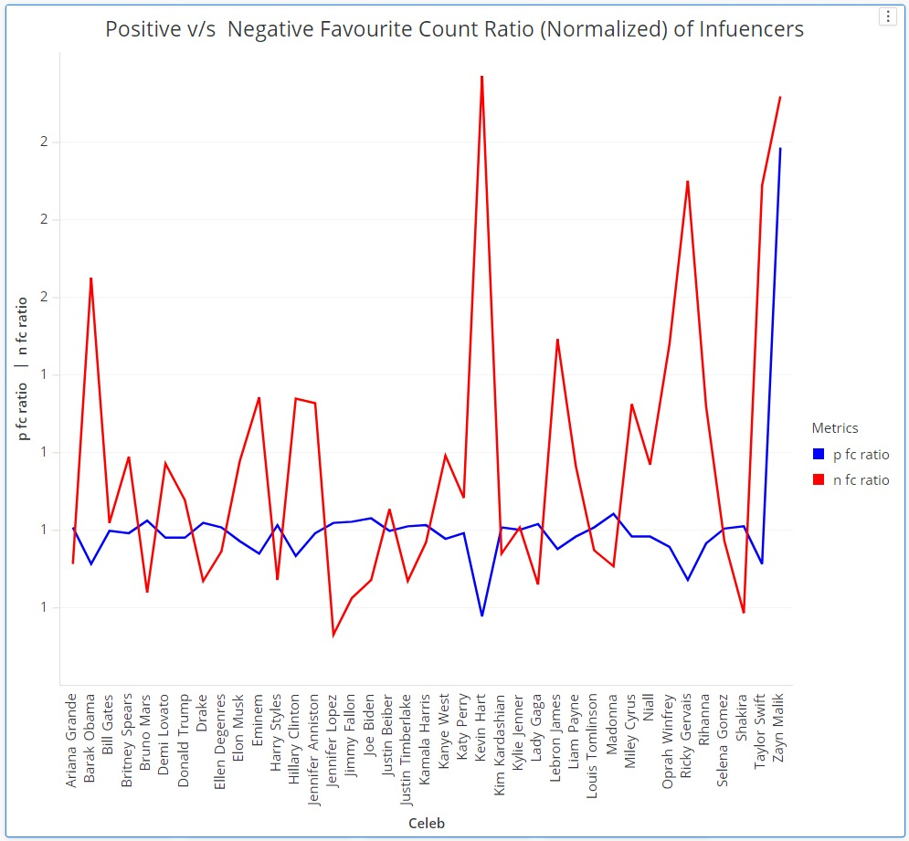

Slide 12
Conclusion
The average ratio taken of all the influencers analyzed:
Positive favourite counts = 0.98
Negative favourite counts = 1.14
Positive retweets = 0.96
Negative retweets = 1.28

Slide 13
Since both the ratios for favourite counts and retweets negative sentiments are greater than that of the positive ones, we can conclude that the negative reaction of any influencer related to any current event be it elections or movements, shapes the opinion of their followers to a significantly greater extent than their positive opinion.

